Slide 1
Pneumonia detection from chest X-ray using Inception-V3
By THOKCHOM KARNELJIT SINGH
Problem and Approach :
To distinguish pneumonia from normal in X- ray images using state of art model : Inception-V3.
Dataset used from Kaggle repository namely PneumoniaMNIST.
File is in .npz format which means images are in numpy array form and compressed for storage efficiency.
.npz consist train, validation, test set with corresponding labels which will feed to fine tune Inception-V3.

Slide 2
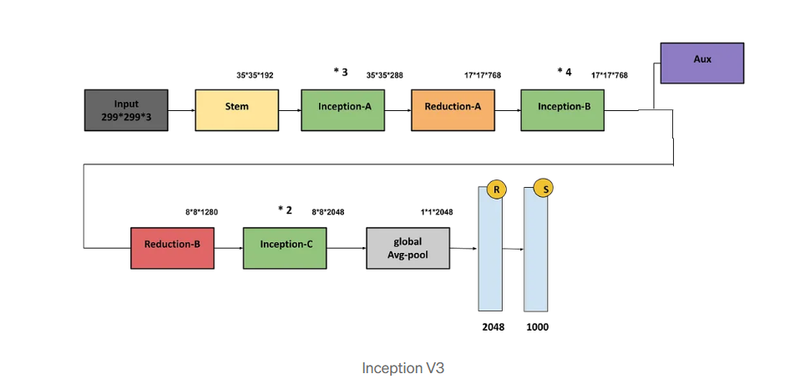
Model Architecture :
Inception-V3 architecture shown above :
Dataset which consist of train (3883), val(524) and test(624) stored in numpy arrays are used accordingly.
Dataset file consist of grayscale 28x28 pixels.
Data is resize to 96x96 to make model learn more fine grain features with care not to overuse system memory resources and hang system.
Inception-V3 top trainable layer is freeze and a custom connected layers is adder with l2 regularilization is added.
Hyper parameter: lr=0.001, batch = 8, epoch=20 , optimizer =Adam.

Slide 3
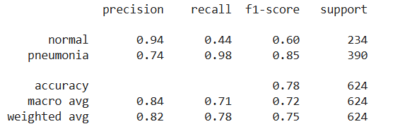
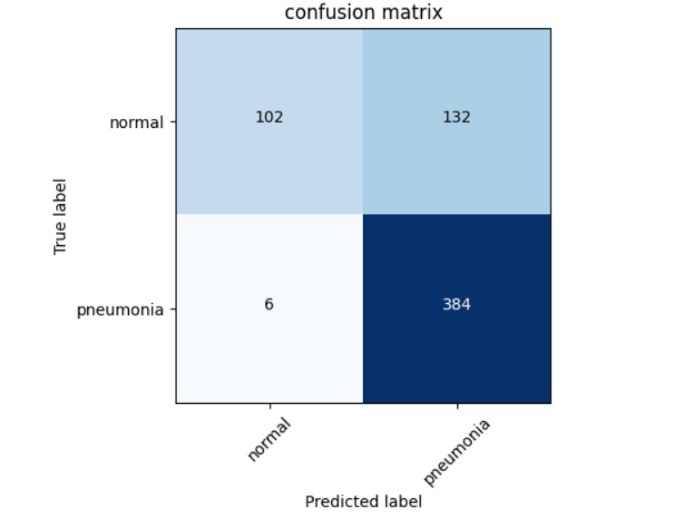
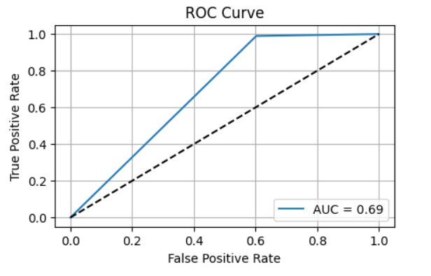
Results :
Three evaluation metrics carried out :
Classification report
Confusion matrix
ROC curve

